Slide 1
Retirement Planner Objectives
A local application that stores financial data related to a family’s retirement investments.
Model the growth of retirement accounts up to and throughout retirement.
Show tax implications and income estimation based on fixed withdraws from retirement accounts.
Inflation calculations to reliably represent the actual value in terms of today’s dollars.
Display the data in tabular format and in graphs for ease of understanding.

Slide 2
Architecture
Built on Node.JS for robust interaction with the OS and a wealth of libraries for functionality.
Utilizing the Electron library to instantiate the HTML and JavaScript user interface.
A modern web interface which utilizing industry standard BootStrap and BootSwatch CSS.
Redux Store provides a global state manager for all data within the application.

Slide 3
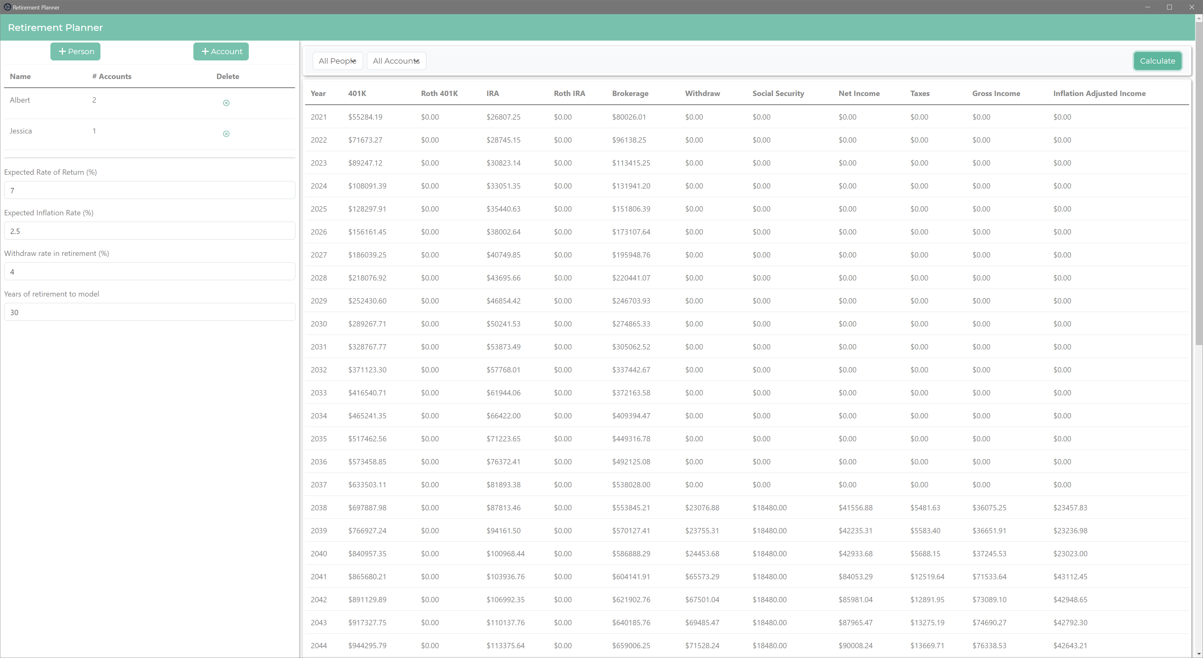
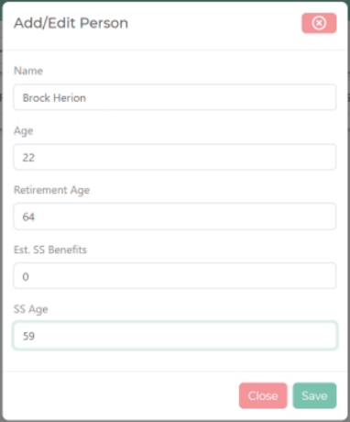
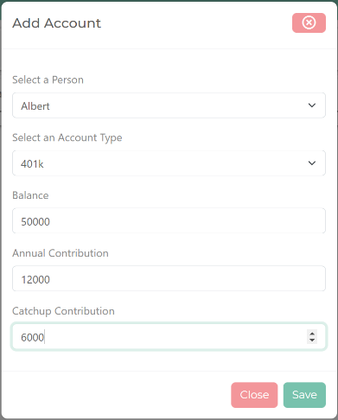
User Interface
A simple intuitive interface like a mobile app
The Model Controls
A tabular display of the current people and accounts
Editable fields for parameters used in calculating the financial model
The Filter Bar
Dropdown menus to filter the displayed data on a person or account
The Results section
A dynamically scalable canvas where the financial model is display
Displays the results of all inputs into the modeling algorithm
Action button opens a popup window to add / edit/ delete people and accounts
An elegant interface with no hidden controls or no menus
Simplified navigation between elements of the programs
A single popup form to add client the users data into the model

Slide 4
Data Model
Redux State Manager
Global state manager for holding all data objects for Persons, Accounts, and records in the modeled dataset
Accounts
Held in the Redux data store
Associated by the Person unique ID
Contains the balance and contribution information used in calculating the account in the model
Static Data
Persons
Held in the Redux data store
Assigned a unique ID to relate the Person and Account objects
Enables actions to trigger on any change of state in the application such as loading the app or creating / editing people or accounts from the data set
Contains all the details of a particular Person object
The unique information for an account type owned by a Person
A static representation of the Persons and Accounts created by the user
The data is saved to a JSON file for easy retrieval the next time the application is loaded by the Redux state manager’s event system

Slide 5
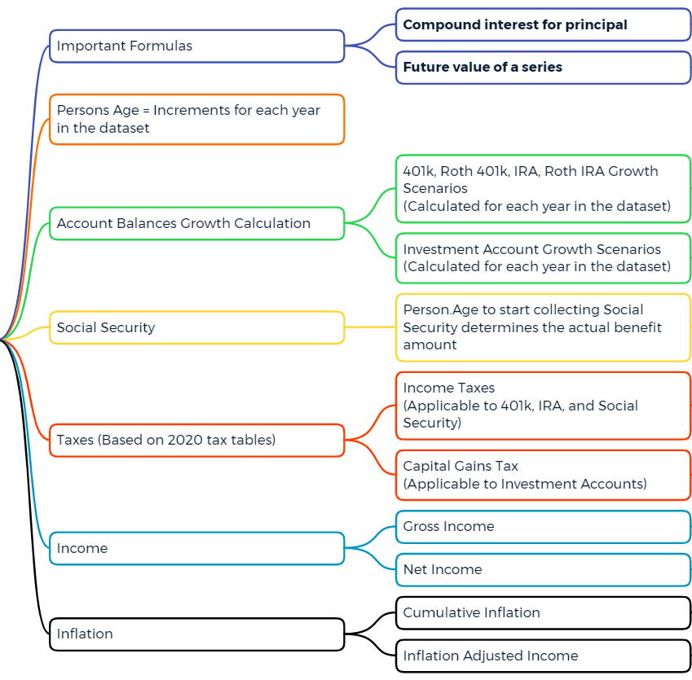
The Retirement Model
Uses industry standard financial calculations to build the model.
Heavily based on Compound Interest and Future Value Series calculations.
Incorporates tax brackets, Social Security benefits, and withdraw rates in retirement to estimate future income in retirement.
Adjusts future dollar amounts based on compounding inflation to display retirement income in terms of the value of today’s dollars.

